Slide 1
Project2 -- K-Means
B10500012 鍾佳欽

Slide 2
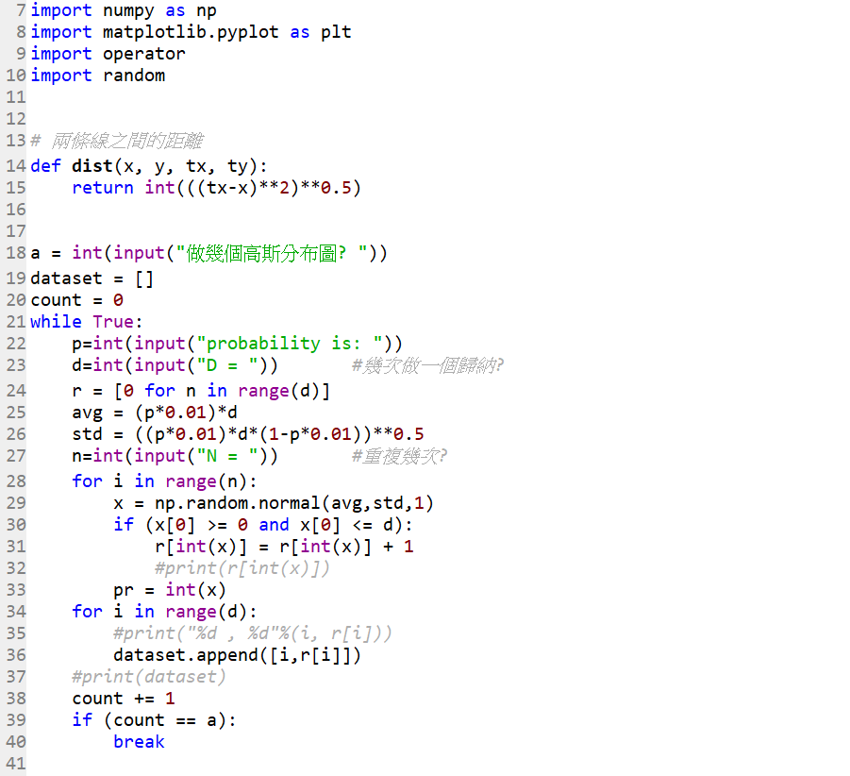
程式碼 (Python)

Slide 3
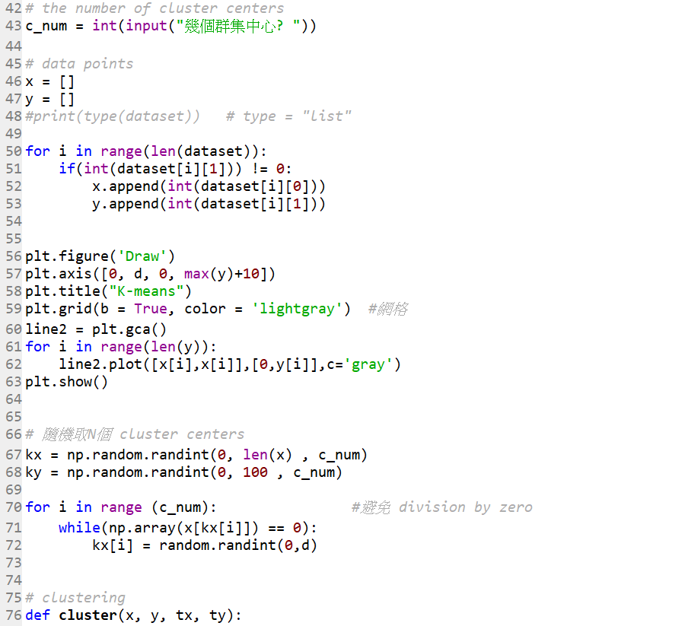
程式碼 (Python)

Slide 4
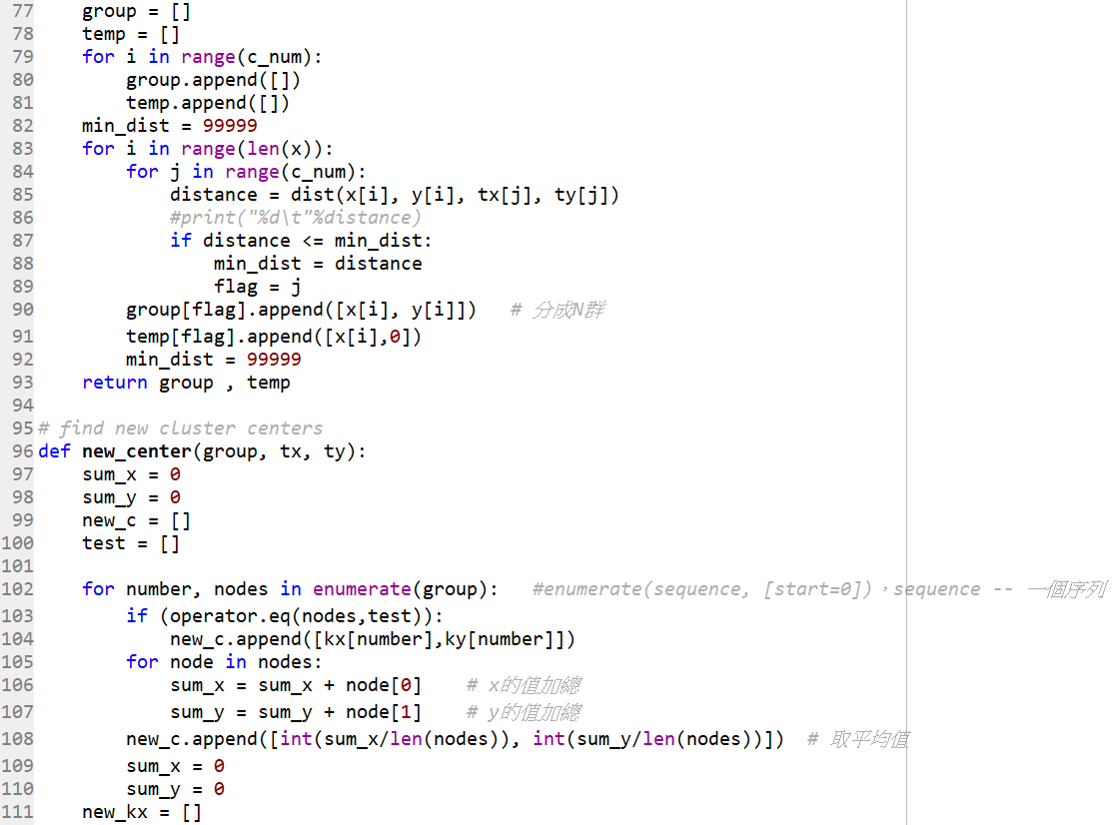
程式碼 (Python)

Slide 5
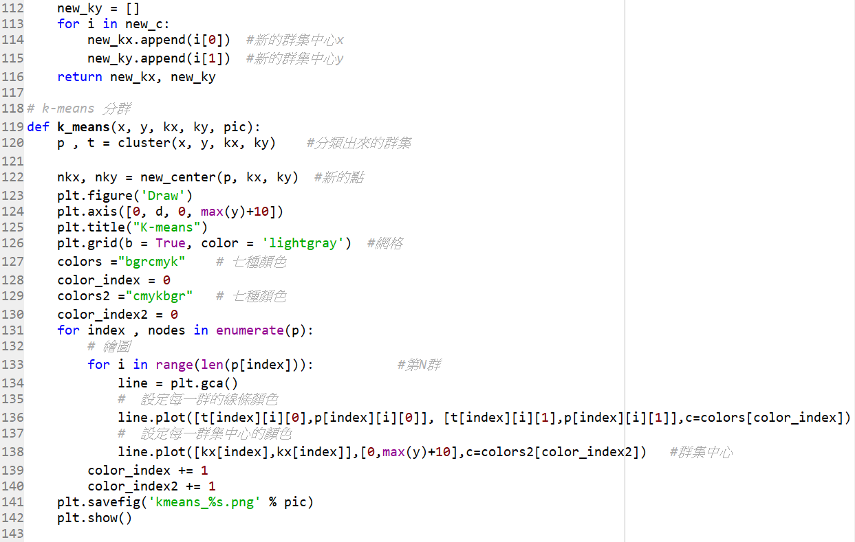
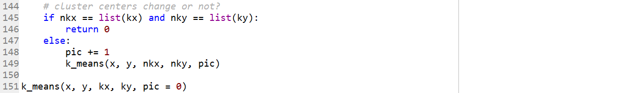
程式碼 (Python)

Slide 6
D = 100 , N = 100 , θ = 1/4 & θ = 1/3

Slide 7
D = 100 , N = 1000 , θ = 1/4 & θ = 1/3

Slide 8
D = 100 , N = 1000 , θ = 1/4 & θ = 1/3 & θ = 1/2

Slide 9
D = 100 , N = 1000 , θ = 1/5 & θ = 1/2 & θ = 4/5

Slide 10
The end

